Slide 1
Apache Spark and Object Stores —What you need to know
Steve Loughran
stevel@apache.org
October 2016

Slide 2


Steve Loughran,
Hadoop committer, PMC member, …
Rajesh Balamohan
Tez Committer, PMC Member
Chris Nauroth,
Apache Hadoop committer & PMC
ASF member
Notes:
Now people may be saying "hang on, these aren't spark developers". Well, I do have some integration patches for spark, but a lot of the integration problems are actually lower down:
-filesystem connectors
-ORC performance
-Hive metastore
Rajesh has been doing lots of scale runs and profiling, initially for Hive/Tez, now looking at Spark, including some of the Parquet problems.
Chris has done work on HDFS, Azure WASB and most recently S3A
Me? Co-author of the Swift connector. author of the Hadoop FS spec and general mentor of the S3A work, even when not actively working on it. Been full time on S3A, using Spark as the integration test suite, since March

Slide 3





Elastic ETL
external
inbound
ORC, Parquet
datasets
HDFS
Notes:
This is one of the simplest deployments in cloud: scheduled/dynamic ETL. Incoming data sources saving to an object store; spark cluster brought up for ETL. Either direct cleanup/filter or multistep operations, but either way: an ETL pipeline. HDFS on the VMs for transient storage, the object store used as the destination for data —now in a more efficient format such as ORC or Parquet

Slide 4


Notebooks
external
datasets
library
Notes:
Notebooks on demand. ; it talks to spark in cloud which then does the work against external and internal data;
Your notebook itself can be saved to the object store, for persistence and sharing.

Slide 5



Streaming
Notes:
Example: streaming on Azure

Slide 6
A Filesystem: Directories, Files → Data
/
work
00
01
pending
complete
00
part-00
part-01
part-01
01
00
01
rename("/work/pending/part-01", "/work/complete")

Slide 7
Object Store: hash(name)->blob
hash("/work/pending/part-00") ["s01", "s02", "s04"]
s01
s02
hash("/work/pending/part-01") ["s02", "s03", "s04"]
00
01
01
00
copy("/work/pending/part-01",
"/work/complete/part01")
s03
s04
delete("/work/pending/part-01")
01
00
01
01
01

Slide 8
REST APIs
PUT /work/pending/part-01 ... DATA ...
s01
s02
GET /work/pending/part-01 Content-Length: 1-8192
00
01
00
PUT /work/complete/part01
x-amz-copy-source: /work/pending/part-01
s03
s04
DELETE /work/pending/part-01
00
01
HEAD /work/complete/part-01
01
GET /?prefix=/work&delimiter=/

Slide 9
What is the Problem?
Cloud Object Stores designed for
Scale
Cost
Geographic Distribution
Availability
Cloud app writers often modify apps to deal with cloud storage semantics and limitations
Challenges - Hadoop apps should work on HDFS or Cloud Storage transparently
Eventual consistency
Performance - separated from compute
Cloud Storage not designed for file-like access patterns
Limitations in APIs (e.g. rename)

Slide 10
Goal and Approach
Goals
Integrate with unique functionality of each cloud
Optimize each cloud’s object store connector
Optimize upper layers for cloud object stores
Overall Approach
Consistency in face of eventual consistency (use a secondary metadata store)
Test at scale
Instrumentation within the tests
Performance in the connector (e.g. lazy seek)
Upper layer improvements (Hive, Spark, ORC, Tez, etc.)

Slide 11




org.apache.hadoop.fs.FileSystem
hdfs
wasb
s3a
swift
adl
gs
Notes:
Everything usies the Hadoop APIs to talk to both HDFS, Hadoop Compatible Filesystems and object stores; the Hadoop FS API. There's actually two: the one with a clean split between client side and "driver side", and the older one which is a direct connect. Most use the latter and actually, in terms of opportunities for object store integration tweaking, this is actually the one where can innovate with the most easily. That is: there's nothing in the way.
Under the FS API go filesystems and object stores.
HDFS is "real" filesystem; WASB/Azure close enough. What is "real?". Best test: can support HBase.

Slide 12
Using object stores in Spark

Slide 13
How to Use Object Stores
Part of a larger application
Source of data: own and public
Persistent output
Sharing results
Sometimes: as a replacement for a cluster-wide filesystem

Slide 14
Four Challenges
Classpath
Credentials
Code
Commitment
Let's look At S3 and Azure

Slide 15
Use S3A to work with S3
(EMR: use Amazon's s3:// )

Slide 16
Classpath: fix “No FileSystem for scheme: s3a”
hadoop-aws-2.7.x.jar
aws-java-sdk-1.7.4.jar
joda-time-2.9.3.jar
(jackson-*-2.6.5.jar)
Get Spark with
Hadoop 2.7+ JARs
See SPARK-7481

Slide 17
Credentials
core-site.xml or spark-default.conf
spark.hadoop.fs.s3a.access.key MY_ACCESS_KEY
spark.hadoop.fs.s3a.secret.key MY_SECRET_KEY
spark-submit automatically propagates Environment Variables
export AWS_ACCESS_KEY=MY_ACCESS_KEY
export AWS_SECRET_KEY=MY_SECRET_KEY
NEVER: share, check in to SCM, paste in bug reports…

Slide 18
Authentication Failure: 403
com.amazonaws.services.s3.model.AmazonS3Exception:
The request signature we calculated does not match
the signature you provided.
Check your key and signing method.
Check joda-time.jar & JVM version
Credentials wrong
Credentials not propagating
Local system clock (more likely on VMs)

Slide 19
Code: Basic IO
// Read in public dataset
val lines = sc.textFile("s3a://landsat-pds/scene_list.gz")
val lineCount = lines.count()
// generate and write data
val numbers = sc.parallelize(1 to 10000)
numbers.saveAsTextFile("s3a://hwdev-stevel-demo/counts")
All you need is the URL

Slide 20
Code: just use the URL of the object store
val csvdata = spark.read.options(Map(
"header" -> "true",
"inferSchema" -> "true",
"mode" -> "FAILFAST"))
.csv("s3a://landsat-pds/scene_list.gz")
...read time O(distance)

Slide 21
DataFrames
val landsat = "s3a://stevel-demo/landsat"
csvData.write.parquet(landsat)
val landsatOrc = "s3a://stevel-demo/landsatOrc"
csvData.write.orc(landsatOrc)
val df = spark.read.parquet(landsat)
val orcDf = spark.read.parquet(landsatOrc)
Notes:
you used to have to disable summary data in the spark context Hadoop options, but https://issues.apache.org/jira/browse/SPARK-15719 fixed that for you

Slide 22
Finding dirty data with Spark SQL
val sqlDF = spark.sql(
"SELECT id, acquisitionDate, cloudCover"
+ s" FROM parquet.`${landsat}`")
val negativeClouds = sqlDF.filter("cloudCover < 0")
negativeClouds.show()
* filter columns and data early
* whether/when to cache()?
* copy popular data to HDFS
Notes:
It looks the same, you just need to be as aggressive about minimising IO as you can
-push down predicates
-only select the columns you want
-filter
-If you read a lot, write to HDFS then re-use.
cache()? I don't know. If you do, filter as much as you can first: columns, predicates, ranges, so that parquet/orc can read as little as it needs to, and RAM use is least.

Slide 23
spark-default.conf
spark.sql.parquet.filterPushdown true
spark.sql.parquet.mergeSchema false
spark.hadoop.parquet.enable.summary-metadata false
spark.sql.orc.filterPushdown true
spark.sql.orc.splits.include.file.footer true spark.sql.orc.cache.stripe.details.size 10000
spark.sql.hive.metastorePartitionPruning true

Slide 24
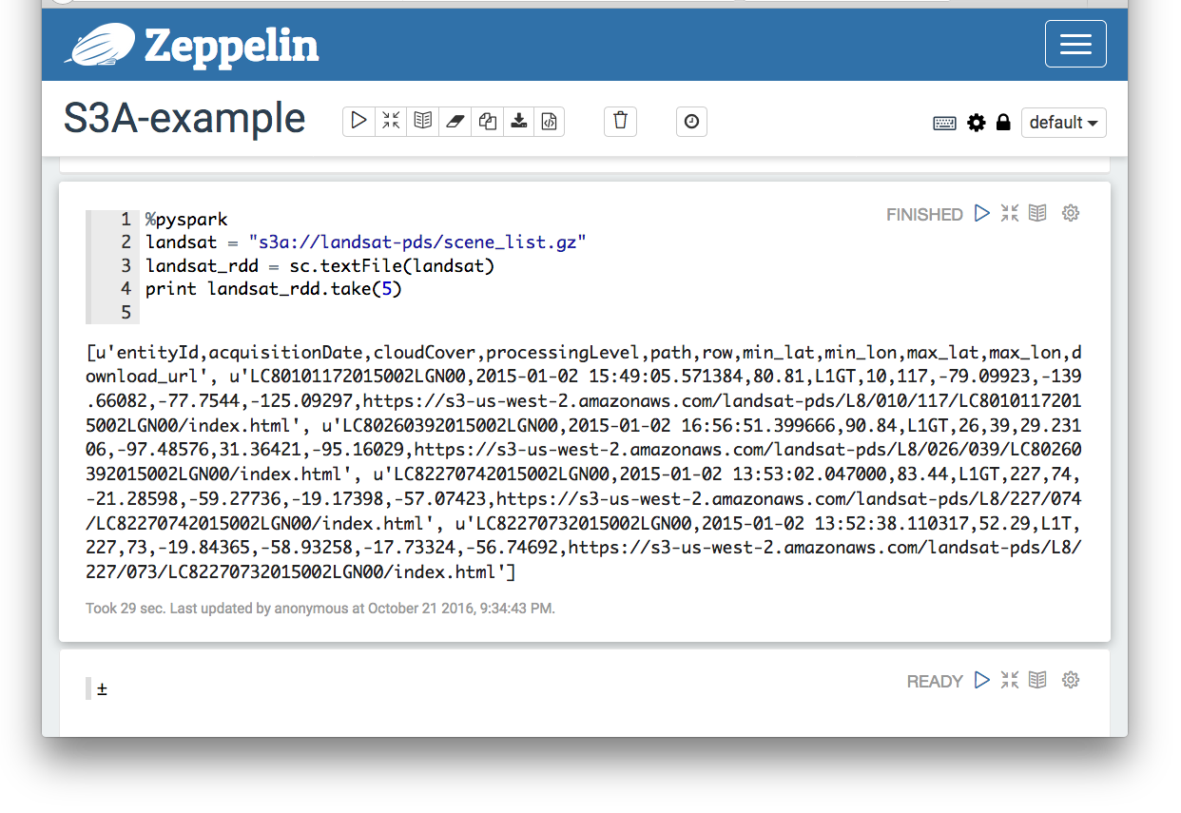
Notebooks? Classpath & Credentials
Notes:
if your distributor didn't stick the JARs in, you can add the hadoop-aws and hadoop-azure dependencies in the interpreter config
credentials: keep out of notebooks. Zeppelin can list its settings too; always dangerous (mind you, so does HDFS and YARN, so an XInclude is handy there)
when running in EC2, S3 credentials are now automatically picked up. And, if zeppelin is launched with the AWS env vars set, its invocation of spark-submit should pass them down.

Slide 25
The Commitment Problem
rename() used for atomic commitment transaction
time to copy() + delete() proportional to data * files
S3: 6+ MB/s
Azure: a lot faster —usually
spark.speculation false
spark.hadoop.mapreduce.fileoutputcommitter.algorithm.version 2
spark.hadoop.mapreduce.fileoutputcommitter.cleanup.skipped true

Slide 26
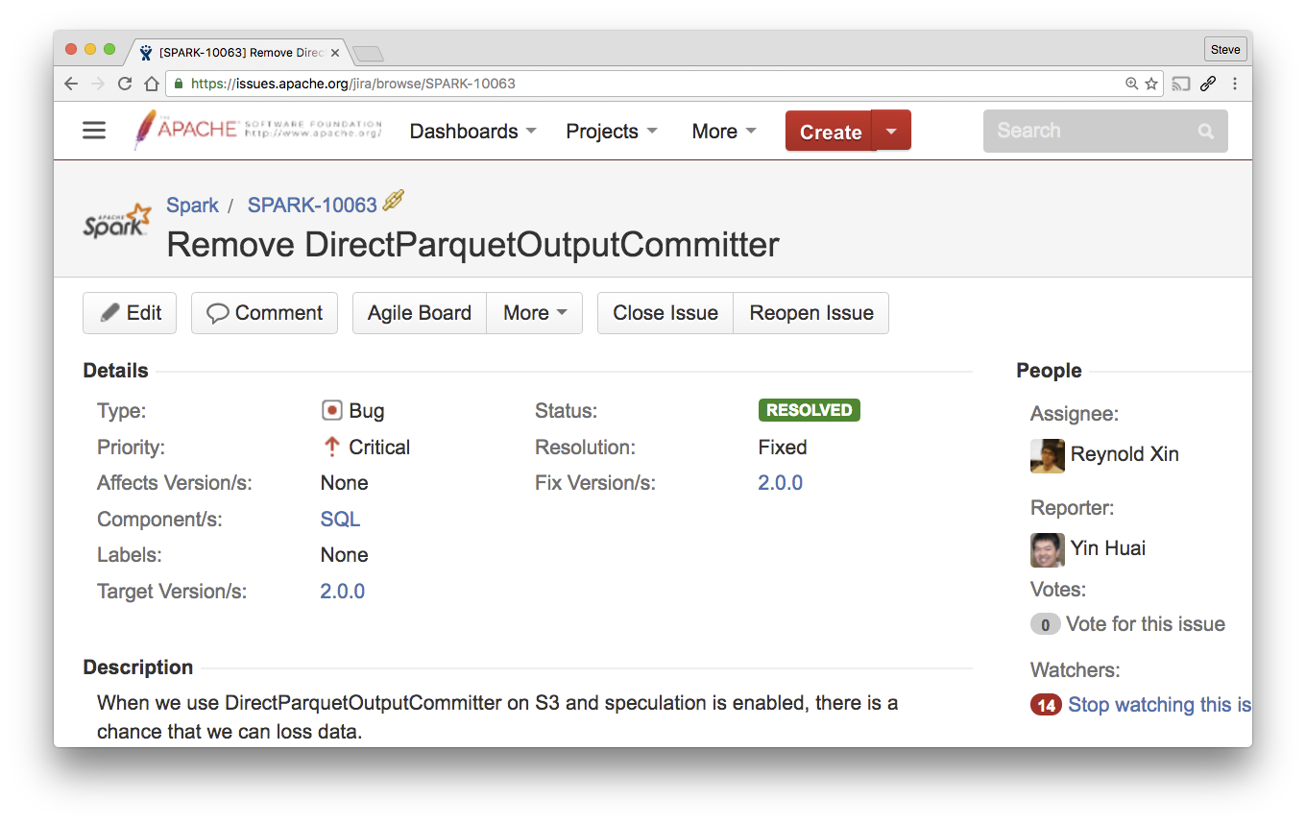
What about Direct Output Committers?
Notes:
This invariably ends up reaching us on JIRA, to the extent I've got a document somewhere explaining the problem in detail.
It was taken away because it can corrupt your data, without you noticiing. This is generally considered harmful.

Slide 27
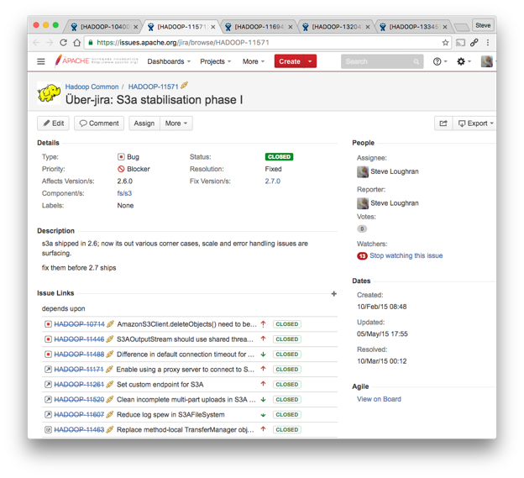
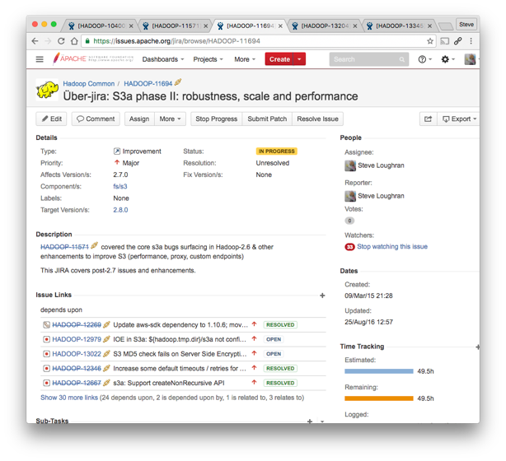
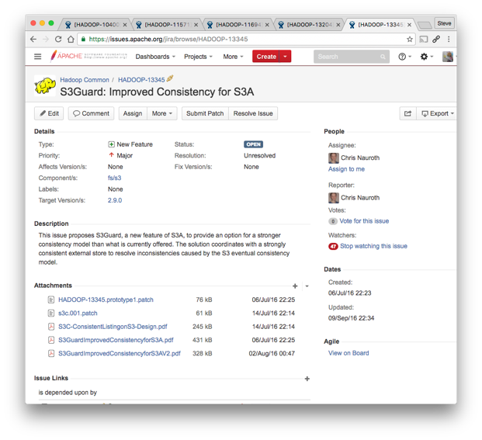
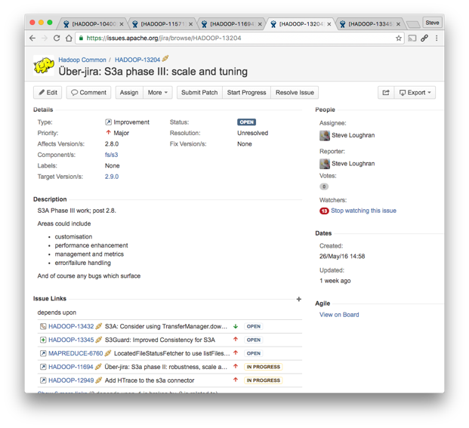
Notes:
This is what's been keeping me busy: adding functionality and perf to S3A, driven by experiments and benchmarking in Hive and Spark.

Slide 28
Recent S3A Performance (Hadoop 2.8, HDP 2.5, CDH 5.9 (?))
// forward seek by skipping stream
spark.hadoop.fs.s3a.readahead.range 157810688
// faster backward seek for ORC and Parquet input
spark.hadoop.fs.s3a.experimental.input.fadvise random
// PUT blocks in separate threads
spark.hadoop.fs.s3a.fast.output.enabled true
Notes:
without going into the details, here are things you will want for Hadoop 2.8. They are in HDP 2.5, possible in the next CDH release.
The first two boost input by reducing the cost of seeking, which is expensive as it breaks then re-opens the HTTPS connection. Readahead means that hundreds of KB can be skipped before that connect (yes, it can take that long to reconnect). The experimental fadvise random feature speeds up backward reads at the expense of pure-forward file reads. It is significantly faster for reading in optimized binary formats like ORC and Parquet
The last one is a successor to fast upload in Hadoop 2.7. That buffers on heap and needs careful tuning; its memory needs conflict with RDD caching. The new version defaults to buffering as files on local disk, so won't run out of memory. Offers the potential of significantly more effective use of bandwidth; the resulting partitioned files may also offer higher read perf. (No data there, just hearsay).

Slide 29
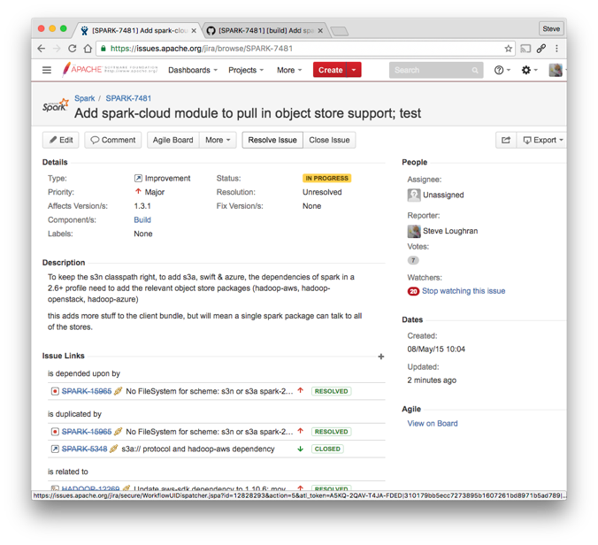
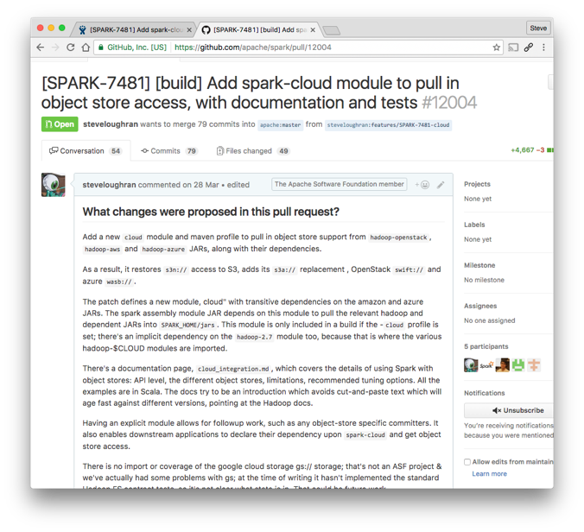
Notes:
Here's a core initial bit of Spark: set up that classpath, test everything. These are both integration tests "is the CP right? do things like DataFrames work?" and scaleable full stack tests. They have CLI entry points for exactly this purpose, with Jenkins @ work sending out mail if anything fails. They aren't performance tests, though they are instrumented and are used to calibrate changes in code operations, to see if things speedup/slowdown. However, as they aren't realistic datasets or directory layouts, that's only microbenchmarking.
Packaging covers: s3a, wasb, swift. Excluded : google gs connector.
As of Oct 2016, this isn't in. Please look at the PR, test, and help review it. I have more plans here, and needto get this in first. The more Spark users asking for cloud integration, the more reviews this gets.

Slide 30
Advanced authentication
<property>
<name>fs.s3a.aws.credentials.provider</name>
<value>
org.apache.hadoop.fs.s3a.SimpleAWSCredentialsProvider,
org.apache.hadoop.fs.s3a.TemporaryAWSCredentialsProvider,
com.amazonaws.auth.EnvironmentVariableCredentialsProvider,
com.amazonaws.auth.InstanceProfileCredentialsProvider,
org.apache.hadoop.fs.s3a.AnonymousAWSCredentialsProvider
</value>
</property>
+encrypted credentials in JECKS files on HDFS
Notes:
Hadoop 2.8 adds a lot of control here. (credit: Netfllx, + later us & cloudera)
-You can define a list of credential providers to use; the default is simple, env, instance, but you can add temporary and anonymous, choose which are unsupported, etc.
-passwords/secrets can be encrypted in hadoop credential files stored locally, HDFS
-IAM auth is what EC2 VMs need

Slide 31
Azure Storage: wasb://
A full substitute for HDFS
Notes:
see: Windows Azure Storage: A Highly Available Cloud Storage Service with Strong Consistency for details, essentially it has the semantics HBase needs, that being our real compatibility test.

Slide 32
Classpath: fix “No FileSystem for scheme: wasb”
wasb:// : Consistent, with very fast rename (hence: commits)
hadoop-azure-2.7.x.jar
azure-storage-2.2.0.jar
+ (jackson-core; http-components, hadoop-common)
Notes:
Azure storage is unique in that there's a pubished paper (+ video) on its internals. Well worth looking at to understand what's going on. In contrast, if you want to know S3 internals, well, you can ply the original author with gin and he still won't reveal anything.
ADL adds okhttp for HTTP/2 performance; yet another json parser for unknown reasons

Slide 33
Credentials: core-site.xml / spark-default.conf
<property>
<name>fs.azure.account.key.example.blob.core.windows.net</name>
<value>0c0d44ac83ad7f94b0997b36e6e9a25b49a1394c</value>
</property>
spark.hadoop.fs.azure.account.key.example.blob.core.windows.net
0c0d44ac83ad7f94b0997b36e6e9a25b49a1394c
wasb://demo@example.blob.core.windows.net
Notes:
Azure storage is unique in that there's a pubished paper (+ video) on its internals. Well worth looking at to understand what's going on. In contrast, if you want to know S3 internals, well, you can ply the original author with gin and he still won't reveal anything.
ADL adds okhttp for HTTP/2 performance; yet another json parser for unknown reasons

Slide 34
Example: Azure Storage and Streaming
val streaming = new StreamingContext(sparkConf,Seconds(10))
val azure = "wasb://demo@example.blob.core.windows.net/in"
val lines = streaming.textFileStream(azure)
val matches = lines.map(line => {
println(line)
line
})
matches.print()
streaming.start()
* PUT into the streaming directory
* keep the dir clean
* size window for slow scans

Slide 35
Not Covered
Partitioning/directory layout
Infrastructure Throttling
Optimal path names
Error handling
Metrics

Slide 36
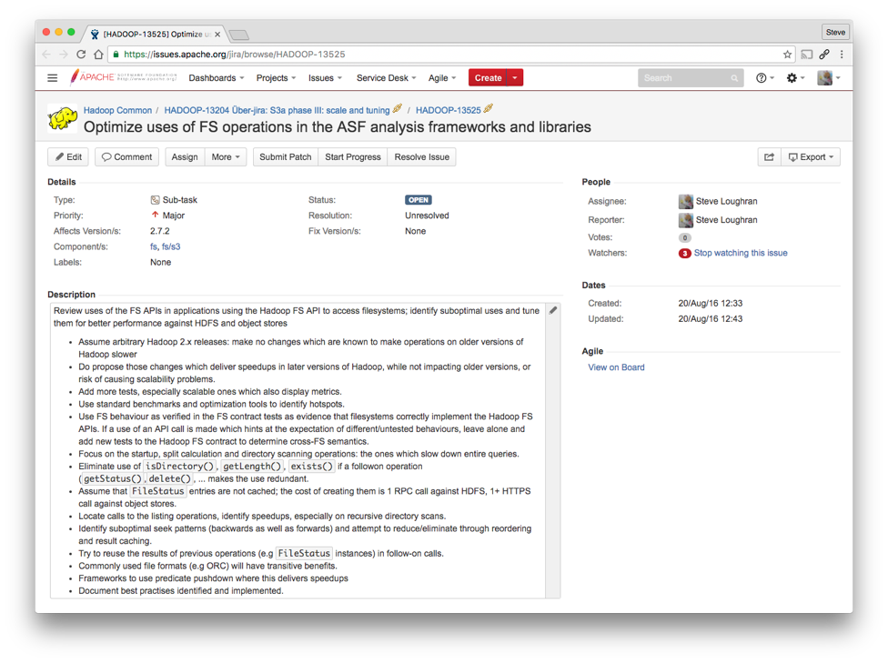
What Next? Performance and integration
Notes:
And this is the big one, as it spans the lot: Hadoop's own code (so far: distcp), Spark, Hive, Flink, related tooling. If we can't speed up the object stores, we can tune the apps

Slide 37
Summary
Object Stores look just like any other URL
…but do need classpath and configuration
Issues: performance, commitment
Use Hadoop 2.7+ JARs
Tune to reduce I/O
Keep those credentials secret!

Slide 38


Slide 39
Backup Slides

Slide 40

Why run your code in the cloud?

Slide 41



2006
2008
2013
2014
2015
2016
s3:// —“inode on S3”
History of Object Storage Support
s3n://
“Native” S3
s3://
Amazon EMR S3
swift://
OpenStack
s3a://
Replaces s3n
gs://
Google Cloud
s3a:// Stabilize
wasb://
Azure WASB
s3a://
Speed and consistency
adl://
Azure Data Lake
oss://
Aliyun
Notes:
This is the history

Slide 42

Storage Use Evolution
Evolution towards cloud storage as the primary Data Lake
Goal
Application
Application
Application
Input
Output
Output
Input
Input
tmp
HDFS
HDFS
HDFS
Output
Backup
Restore
Copy

Slide 43
Often: Eventually Consistent
s01
s02
GET /work/pending/part-00
00
01
200
00
DELETE /work/pending/part-00
200
s03
s04
01
00
GET /work/pending/part-00
01
200

Slide 44
S3 Server-Side Encryption
Encryption of data at rest at S3
Supports the SSE-S3 option: each object encrypted by a unique key using AES-256 cipher
Now covered in S3A automated test suites
Support for additional options under development (SSE-KMS and SSE-C)

Slide 45
Supportability
Documentation
Backfill missing documentation, and include documentation in new enhancements
To be published to hadoop.apache.org with Apache Hadoop 2.8.0 release
Meanwhile, raw content visible on GitHub:
https://github.com/apache/hadoop/blob/branch-2.8/hadoop-tools/hadoop-aws/src/site/markdown/tools/hadoop-aws/index.md
Error Reporting
Identify common user errors and provide more descriptive error messages
S3 HTTP error codes examined and translated to specific error types
Instrumentation
Internal metrics covering a wide range of metadata and data operations
Already proven helpful in flagging a potential performance regression in a patch

Slide 46
Next Steps for all Object Stores
Output Committers
Logical commit operation decoupled from rename (non-atomic and costly in object stores)
Object Store Abstraction Layer
Avoid impedance mismatch with FileSystem API
Provide specific APIs for better integration with object stores: saving, listing, copying
Ongoing Performance Improvement
Consistency

Slide 47
Performance Considerations When Running Queries
Splits Generation
File formats like ORC provides threadpool in split generation
ORC Footer Cache
hive.orc.cache.stripe.details.size > 0
Caches footer details; Helps in reducing data reads during split generation
Reduce S3A reads in Task side
hive.orc.splits.include.file.footer=true
Sends ORC footer information in splits payload.
Helps reducing the amount of data read in task side.

Slide 48
Hadoop-compatible File System Architecture
Applications
File system interactions coded to file system-agnostic abstraction layer.
FileSystem class - traditional API
FileContext/AbstractFileSystem classes - newer API providing split between client API and provider API
Can be retargeted to a different file system by configuration changes (not code changes).
Caveat: Different FileSystem implementations may offer limited feature set.
Example: Only HDFS and WASB can run HBase.
File System Abstraction Layer
Defines interface of common file system operations: create, open, rename, etc.
Supports additional mix-in interfaces to indicate implementation of optional features.
Semantics of each operation documented in formal specification, derived from HDFS behavior.
File System Implementation Layer
Each file system provides a set of concrete classes implementing the interface.
A set of common file system contract tests execute against each implementation to prove its adherence to specified semantics.

Slide 49
Cloud Storage Connectors
Azure | WASB | Strongly consistent Good performance Well-tested on applications (incl. HBase)
 | ADL | Strongly consistent Tuned for big data analytics workloads
Amazon Web Services | S3A | Eventually consistent - consistency work in progress by Hortonworks Performance improvements in progress Active development in Apache
 | EMRFS | Proprietary connector used in EMR Optional strong consistency for a cost
Google Cloud Platform | GCS | Multiple configurable consistency policies Currently Google open source Good performance Could improve test coverage

Slide 50
Scheme | Stable since | Speed | Consistency | Maintenance
s3n:// | Hadoop 1.0 |  |  | (Apache)
s3a:// | Hadoop 2.7 | 2.8+ | ongoing | Apache
swift:// | Hadoop 2.2 |  |  | Apache
wasb:// | Hadoop 2.7 | Hadoop 2.7 | strong | Apache
adl:// | Hadoop 3
EMR s3:// | AWS EMR |  | For a fee | Amazon
gs:// | ??? |  |  | Google @ github
Notes:
Ignoring Hadoop's own S3

Slide 51
Dependencies in Hadoop 2.8
hadoop-aws-2.8.x.jar
aws-java-sdk-core-1.10.6.jar
aws-java-sdk-kms-1.10.6.jar
aws-java-sdk-s3-1.10.6.jar
joda-time-2.9.3.jar
(jackson-*-2.6.5.jar)
hadoop-aws-2.8.x.jar
azure-storage-4.2.0.jar

